Slide 1
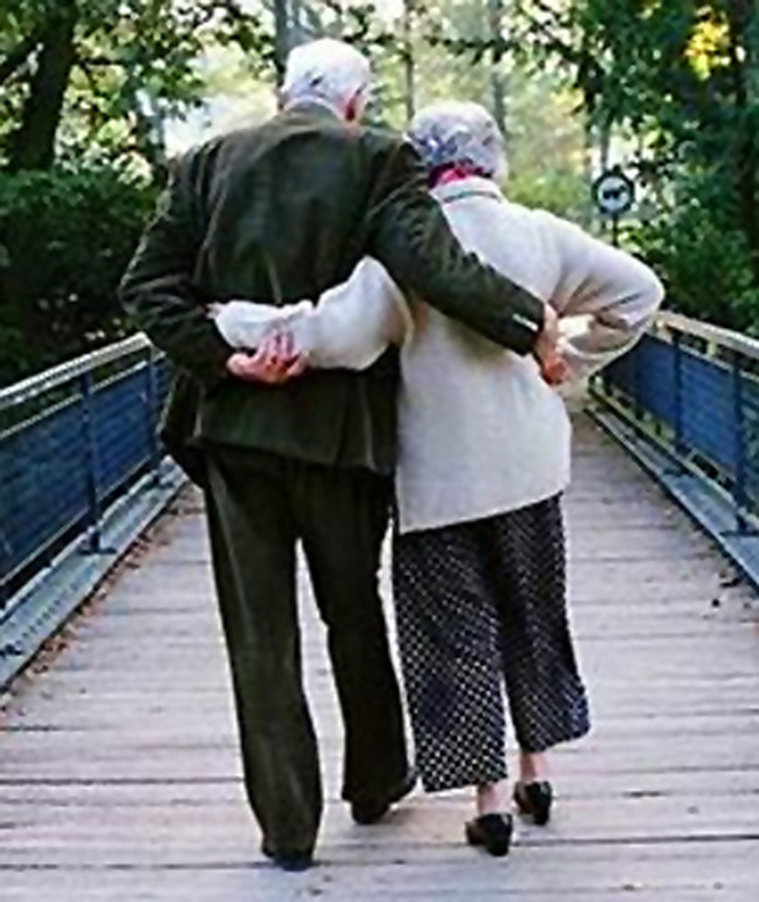
Married: Growing & Serving Together
Marriage is Made in Heaven – Part 3
A Study of Marriage, Spring 2023

Slide 2
Genesis 3:1-6 Sin Changes Everything
The Serpent (Satan) enters the picture (...”that ancient serpent, who is called the devil and Satan, the deceiver of the whole world.” Rev. 12:9
He said to the woman: “Did God really say, ‘You must not eat from any tree in the garden’?”
She replied, “We may eat fruit from the trees in the garden, but God did say, ‘You must not eat fruit from the tree that is in the middle of the garden, and you must not touch it, or you will die.’ ”
Satan said, “You will not certainly die, For God knows that when you eat from it your eyes will be opened, and you will be like God, knowing good and evil.”
Satan was asking the woman to believe him instead of God.
“When the woman saw that the fruit of the tree was good for food (lust of flesh) and pleasing to the eye (lust of eyes), and also desirable for gaining wisdom (vainglory of life), she took some and ate it. She also gave some to her husband, who was with her, and he ate it.”

Slide 3
Genesis 3:11ff Sin Changes Everything, cont.
He (God) said, “Who told you that you were naked? Have you eaten of the tree of which I commanded you not to eat?” The man said, “The woman whom you gave to be with me, she gave me fruit of the tree, and I ate.” Then the LORD God said to the woman, “What is this that you have done?” The woman said, “The serpent deceived me, and I ate.”
The LORD God said to the serpent, “Because you have done this, cursed are you ...and dust you shall eat all the days of your life. (v.15) I will put enmity between you and the woman, and between your offspring and her offspring;
He shall bruise your head, and you shall bruise his heel.” (Messianic promise)
(v.16) To the woman he said, “I will surely multiply your pain in childbearing; in pain you shall bring forth children. Your desire shall be contrary to your husband, but he shall rule over you.” (ESV) (This is not a loving desire)
Compare Gen. 4:7 where God told Cain, “...sin is crouching at the door; and its desire is for you, but you must master it.” (NASB)
“The desire of the women for her husband is akin to the desire of sin that lies poised ready to leap at Cain. It means a desire to break the relationship of equality & turn it into a relationship of servitude & domination.” – Victor Hamilton
Notes:
Nathan Ward, “The judgement on mankind is withheld until the prospect of victory is presented.” Already can see that God condemns sin but seeks to save the sinner.
Most of the older translations say the women’s desire will be to/for your husband.

Slide 4
Genesis 3:11ff Sin Changes Everything, cont.
He (God) said, “Who told you that you were naked? Have you eaten of the tree of which I commanded you not to eat?” The man said, “The woman whom you gave to be with me, she gave me fruit of the tree, and I ate.” Then the LORD God said to the woman, “What is this that you have done?” The woman said, “The serpent deceived me, and I ate.”
The LORD God said to the serpent, “Because you have done this, cursed are you ...and dust you shall eat all the days of your life. (v.15) I will put enmity between you and the woman, and between your offspring and her offspring;
He shall bruise your head, and you shall bruise his heel.” (Messianic promise)
(v.16) To the woman he said, “I will surely multiply your pain in childbearing; in pain you shall bring forth children. Your desire shall be contrary to your husband, but he shall rule over you.”
(17-20) And to Adam he said, “Because you have listened to the voice of your wife and have eaten of the tree of which I commanded you, ‘You shall not eat of it,’ cursed is the ground because of you... till you return to the ground, for out of it you were taken; for you are dust, and to dust you shall return.”
The man called his wife’s name Eve, because she was the mother of all living.
“To ‘love and cherish’ has become to ‘desire and dominate.’”- Kidner, Derek, Genesis: An Introduction & Commentary
Notes:
Adam’s belief in God’s promise is manifested in the naming of his wife.

Slide 5
Lessons from the Fall
Sinful disobedience to God ruined the paradise for the man & women
The fall brought many curses, and the dynamic of marriage has never been one of perfect harmony since.
Our God-given gender differences can become a major source of marital disagreements rather that mutual help.
In a sinful, broken world, authority is constantly abused. Genesis 3:16 says specifically that men will tend to dominate women unless they have the self control to avoid this selfish behavior.
We are wired to desire close human relationships, but none will ever be perfect this side of eternity.
This should cause us to extend gentleness & tolerance toward ea. other
“We must never be naïve enough to think of marriage as a safe harbor from the fall... the deepest struggles of life will occur in the most primary relationship affected by the fall: Marriage.” – Dan Allender and Tremper Longman III, Intimate Allies
However, the roles & basic natures of male & female were unchanged.
Notes:
We must not underestimate the effect of the fall on marriage.
But thousands of years later, Jesus went back to God’s first institution of marriage and still said what happened before the fall was still God’s ultimate goal for marriages in that day.

Slide 6
Becoming One Flesh Is Hard Work!
God provided the man a strong, complementary, counterpart helper, so that together as one flesh, they could become a complete whole.
In marriage, two must become one through deep character change
To fill the void in man, God fashioned the woman to be just what the man needed - not just a lover, but a partner, a companion, a friend!
God’s plan for marriage is to produce deep character change in us through deep friendship.
The person you marry must be your best friend!
“He is my lover and friend” (SoS 5:16, CEV)
“That (adulterous woman) forsaketh the friend of her youth, and forgetteth the covenant of her God” (Prov. 2:17, ASV)
Heb. - ‘allup: friend, guide, close companion see also Prov. 16:28:
“A perverse person stirs up conflict, and a gossip separates close friends.”

Slide 7
It is typical for a single person to walk into a room and see a number of people of the opposite sex and immediately begin to screen them, not for companionship but for attractiveness. Let’s say three out of the ten look appealing. The next step is to approach those three to see what rapport there may be. If one of them will agree to go out on a date, and you get romantically involved, perhaps you’ll see if you can turn that person into a friend as well.
The Problem of the “Modern” Dating Approach
The problem is many of your best prospects for friendship were likely among those you ruled out because they were too tall or too short, too fat or too skinny. We think of a prospective spouse as primarily a lover (or a provider), and if he or she can be a friend on top of that, well isn’t that nice! We should be going at it the other way around. Screen first for friendship. Look for someone who understands you better than you do yourself, who makes you a better person just by being around them. And then explore whether that friendship could become a romance and a marriage. From The Meaning of Marriage by Tim and Kathy Keller

Slide 8
“It often happens that you have a good friend of the opposite sex with whom you share common commitments. You trust this person’s wisdom and you find you can open up and share many intimate things without fear. He or she understands you well and listens to you and gives you great advice. But the person doesn’t attract you romantically. Maybe he or she doesn’t have the body type that you find appealing. You feel no sexual chemistry at all. Then imagine that you meet someone else to whom you feel very attracted. This person has the physical and social attributes you have been looking for and is interested in you, too. So, you start seeing each other and you have a lot of fun together and things are moving along into more and more romantic intimacy. But if you are honest with yourself, this person you say you are falling in love with does not make nearly as good a friend as the one you already have, nor is that likely to change.
What Would You Do?
You are in trouble!
Your spouse has got to be your best friend or be on the way to becoming your best friend, or you won’t have a strong, rich marriage that endures and that makes you both vastly better persons for having been in it. From The Meaning of Marriage by Tim and Kathy Keller

Slide 9
